Slide 1

Vel Tech Rangarajan Dr. Sagunthala R&D Institute of Science and Technology
School of Computing
Department of Computer Science and Engineering
10211CS224 / FULL STACK APPLICATION DEVELOPMENT (JAVA)
END SEMISTER PROJECT REVIEW
Date: 06-05-2026
Job Portal Management System
SDG: SDG No – SDG 4- Quality Education
Presented By:
V Nanda Srinivas– VTU25911– Reg.No:23UECS0612
Courses Handling Faculty:
Dr. Hafizur Rahman

Slide 2
INTRODUCTION
A job portal is a web-based application that connects job seekers (students) with employers in a centralized platform.
It enables students to create profiles, upload resumes, and search for jobs based on skills, location, and experience.
Employers can post job openings, manage job listings, and efficiently recruit suitable candidates.
The system provides an organized way to apply for jobs and track application status (Applied, Shortlisted, Rejected).
It includes secure user authentication and role-based access for students, employers, and administrators.
The portal sends email notifications to users when they apply for jobs and when their application status is updated.
The application is developed using technologies like HTML, CSS, JavaScript, Spring Boot (or PHP), and MySQL database.
Overall, the system improves communication, reduces manual effort, and makes the hiring process faster and more efficient
1
2
3
4
5
6
7
8
9

Slide 3
PROBLEM STATEMENT
1
The traditional job search and recruitment process is often manual, time-consuming, and unorganized. Students find it difficult to search for suitable jobs from multiple sources, while employers struggle to manage large numbers of applications efficiently. There is no centralized platform to track job applications and their status. This leads to delays, confusion, and missed opportunities for both job seekers and recruiters. Communication between students and employers is also limited and inefficient. Therefore, there is a need for a simple, centralized, and automated job portal system. This system will streamline job posting, searching, and application tracking. It will improve efficiency, accuracy, and accessibility for all users.
2
3
4
5
6
7
8
9

Slide 4
OBJECTIVE(S)
1
To develop a web-based job portal that connects students and employers on a single platform.
To enable easy job posting, searching, and online application for efficient recruitment.
To provide application tracking and email notifications, improving communication and transparency.
2
3
4
5
6
7
8
9

Slide 5
PROPOSED SYSTEM
The proposed system is a web-based job portal that connects students and employers through a single, centralized platform.
It provides secure registration and login with role-based access for students, employers, and administrators.
Employers can post, update, and manage job listings, reducing dependency on manual recruitment processes.
Students can search, filter, and apply for jobs online, saving time and effort compared to traditional methods.
The system includes application status tracking, allowing users to monitor progress (Applied, Shortlisted, Rejected).
It solves existing issues by eliminating scattered job information, improving organization, and reducing delays in communication.
Email notifications keep users updated about job applications and status changes, ensuring timely communication.
Compared to current systems, it offers faster processing, better accessibility, improved accuracy, and enhanced user experience.
1
2
3
4
5
6
7
8
9

Slide 6
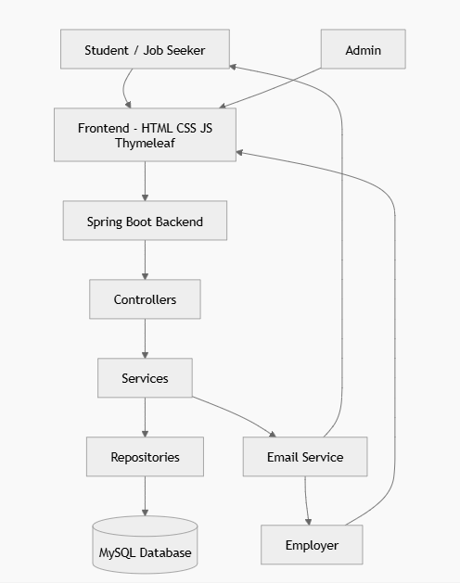
PROPOSED SYSTEM ARCHITECTURE
1
2
3
4
5
6
7
8
9

Slide 7
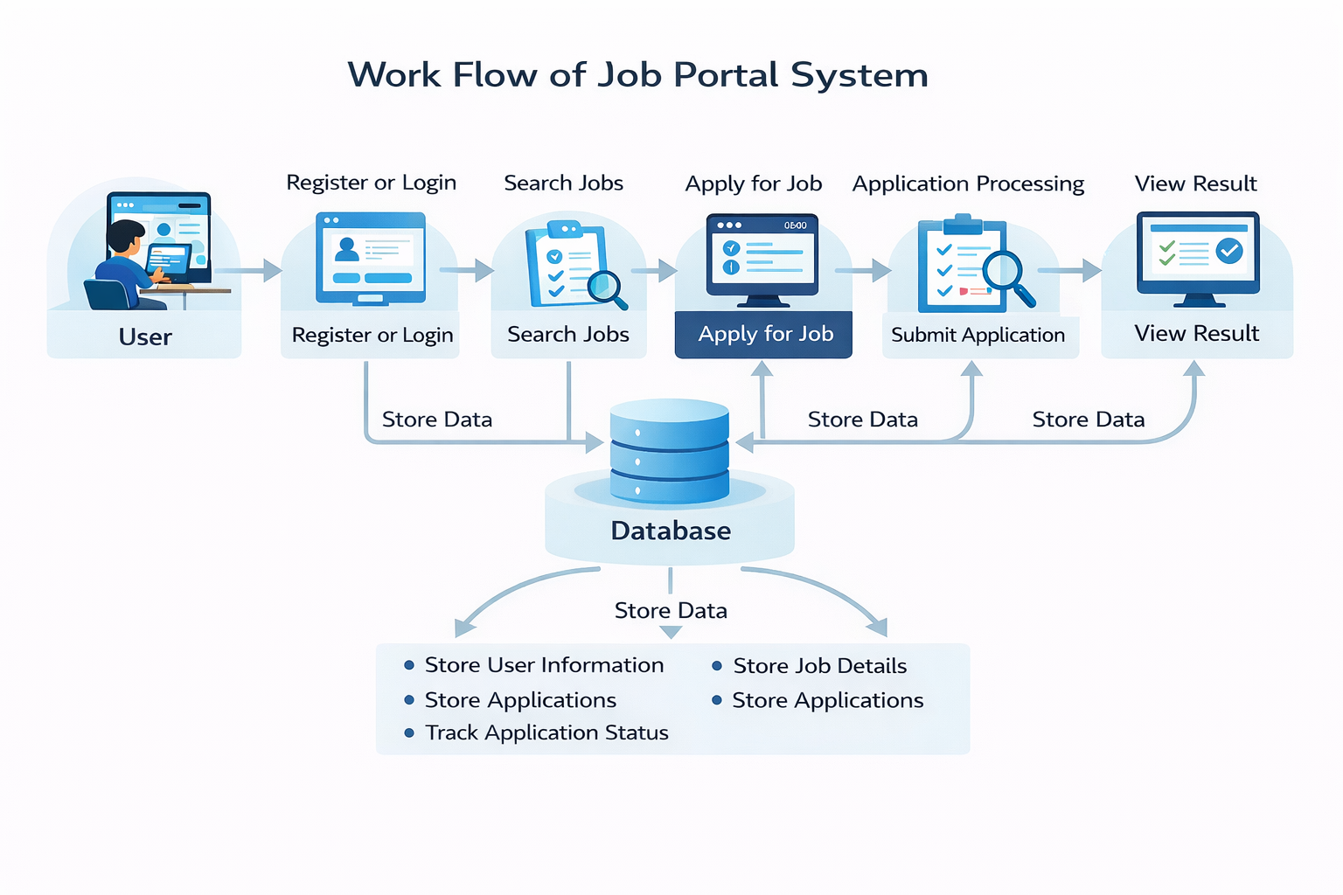
WORKFLOW
1
2
3
4
5
6
7
8
9

Slide 8
TECHNOLOGIES USED
Frontend:
HTML5
CSS3
Backend:
PHP (Core PHP)
Session Management
MySQL(Database Connectivity)
Database:
MySQL
phpMyAdmin
Tools:
XAMPP (Apache + MySQL Server)
Notepad
Web Browser (Chrome)
Hardware / Software Requirements:
System: Windows 10
RAM: Minimum 4GB
Software: XAMPP Server
1
2
3
4
5
6
7
8
9

Slide 9
MODULE DESCRIPTION
1
Module 1: User Management
Handles student and employer registration, login, and profile management with secure authentication.
Module 2: Job Management
Allows employers to post, edit, and delete job listings, and enables students to view available jobs.
Module 3: Application Processing
Manages job applications, allowing students to apply and employers to shortlist or reject candidates.
Module 4: Database Management
Stores user details, job information, and application records while ensuring data integrity and retrieval.
Module 5: Dashboard & Reporting
Displays dashboards for students and employers, showing job activities, application status, and basic insights.
2
3
4
5
6
7
8
9

Slide 10
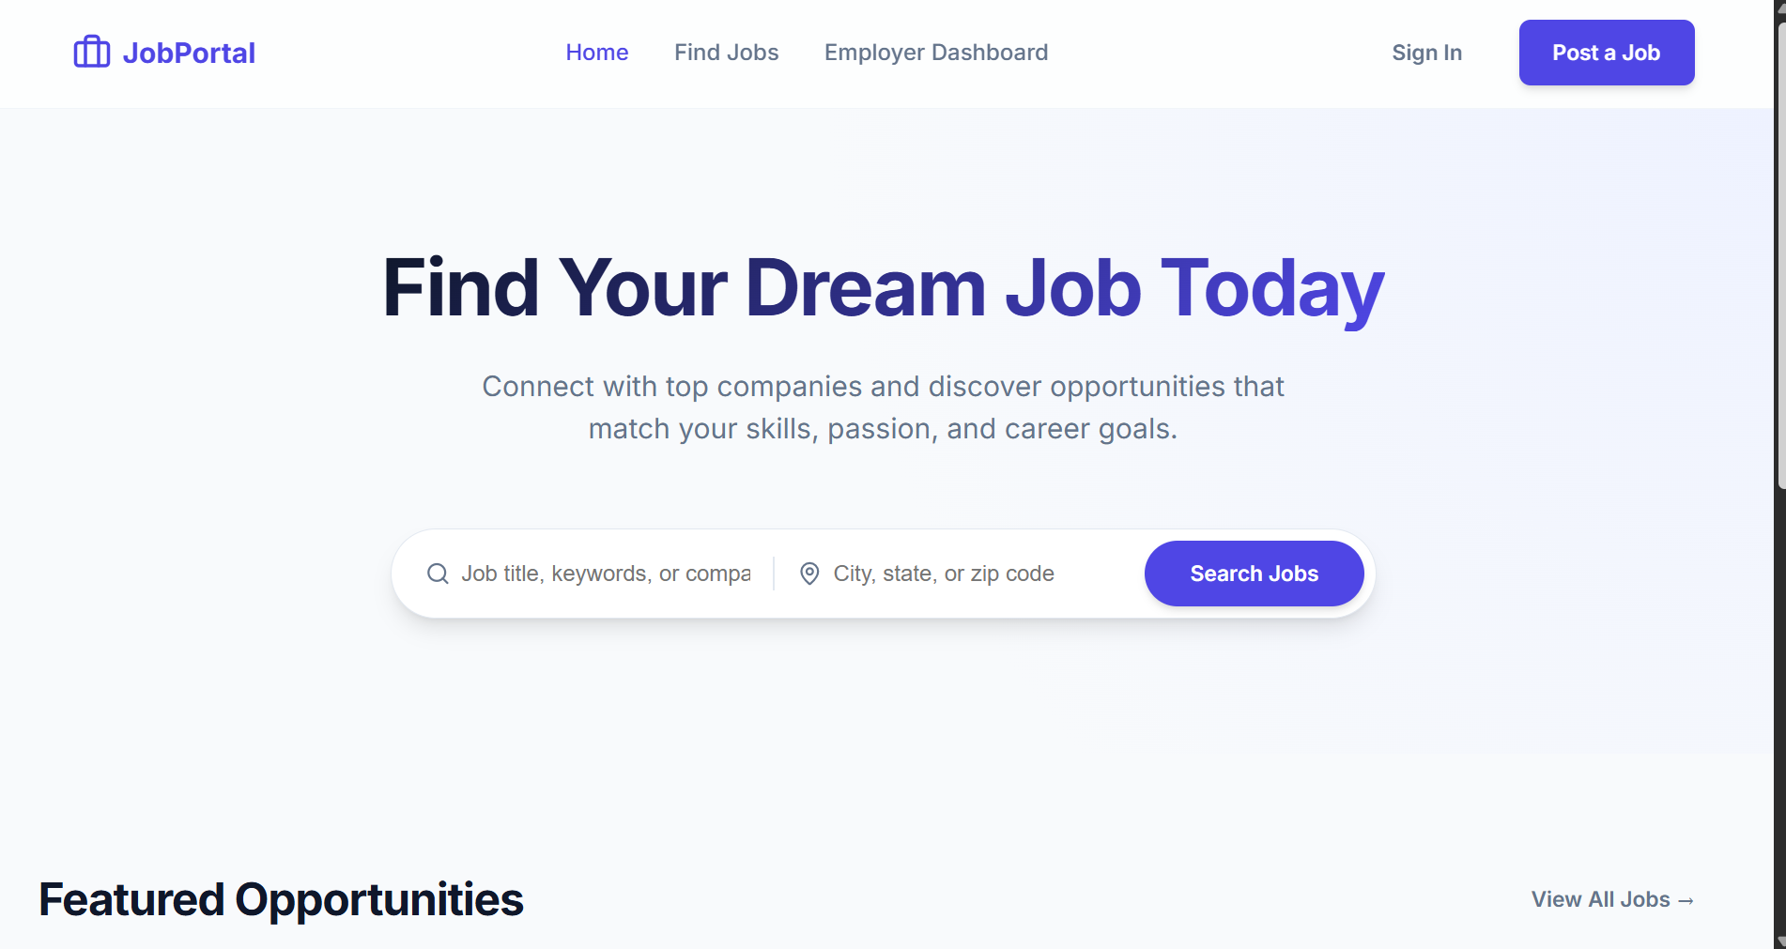
IMPLEMENTATION SCREENSHOTS
1
2
3
4
5
6
7
8
9
This is the homepage of a job portal platform where users can connect with employers and explore career opportunities. It provides options to sign up or log in and helps users get started with job searching or hiring.

Slide 11
IMPLEMENTATION SCREENSHOTS
1
2
3
4
5
6
7
8
9
Login Page :Allows students and employers to log into the system. Validates user credentials and redirects to respective dashboards. Ensures secure authentication using sessions.

Slide 12
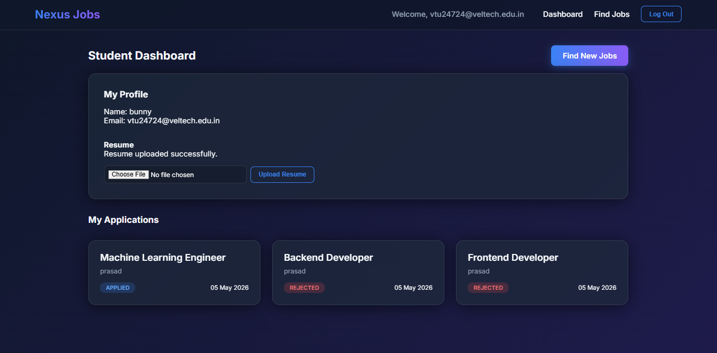
IMPLEMENTATION SCREENSHOTS
1
2
3
4
5
6
7
8(A)
9
Student Dashboard Page
Displays student options like jobs, applied jobs, and profile. Provides navigation to different student functionalities. Shows basic user information and updates.

Slide 13
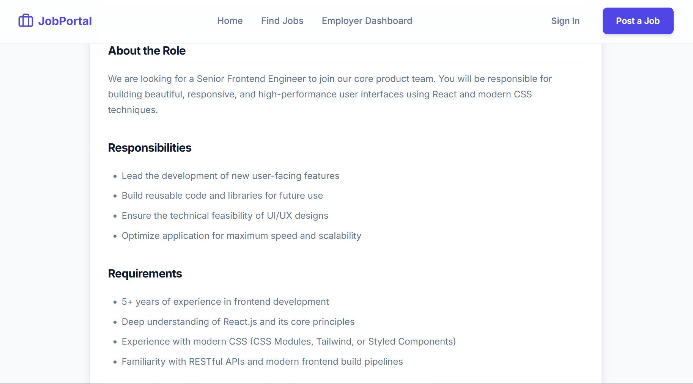
IMPLEMENTATION SCREENSHOTS
1
2
3
4
5
6
7
8(C)
Applied Jobs Page
Shows jobs applied by the student. Displays application status such as Applied, Shortlisted, or Rejected. Helps users track their job applications.
9

Slide 14
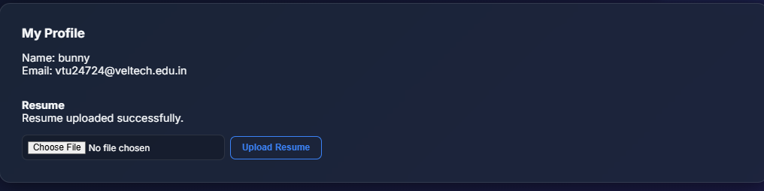
IMPLEMENTATION SCREENSHOTS
1
2
3
4
5
6
7
8(C)
Profile Page
Displays user details like name, email, and role. Allows users to view their personal information. Can be extended to update profile and upload resume
9

Slide 15
ADVANTAGES & LIMITATIONS
ADVANTAGES
Provides a centralized platform for job seekers and employers.
Saves time and effort in job searching and recruitment.
Allows easy job application and status tracking.
Improves communication between students and employers.
Accessible anytime through the web application.
LIMITATIONS
Requires stable internet connection.
Limited advanced features like AI-based job matching.
Security needs improvement for real-world usage.
Not suitable for handling very large-scale users.
No real-time notifications in the current system.
1
2
3
4
5
6
7
8
9

Slide 16
Thank you

